Slide 1

ET-E16 Digital Communications and Multimedia Engineering AC4150E – Human Machine Interaction Instructors: Prof. Thanh-Hai Tran, Dr. Viet-Tung Nguyen
Group 4 : Ma Khoa Hoc - 20210388
Phung Minh Chien - 20213565
Nguyen Danh Huy - 20213571

Slide 2

Human Machine Interaction
Project idea: Chatbot for documents

Slide 3
Content
I.Introduction
II.Needfinding methodology
III.Interview/ Observation results
IV.Analysis
V.Summary

Slide 4


I. Introduction
Developing a document chatbot to enhance how users interact with and search for information within files.
The chatbot will enable quick retrieval of information from documents through natural language queries.
The goal is to create an intuitive, user-friendly interface that boosts productivity and collaboration in document management.

Slide 5
II. Needfinding methodology
Who, Why, When, Where ?
General Users (3 participants)
Advanced Users (1 participant):They can provide in-depth feedback on optimizing the chatbot’s functionality, develop the functions related to extracting information from documents in a more convenient way.
Inexperienced Users (1 participant): They can provide critical feedback on the way to approach our application for new users.
The interview was held on MS team and Discord platform from 9 to 11 pm on Tuesday October 21, 2024

Slide 6
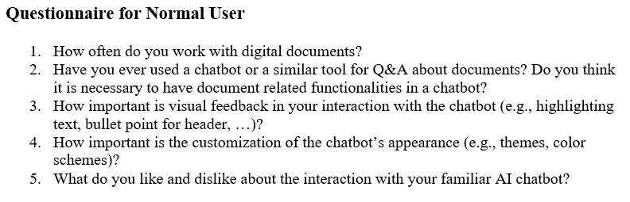
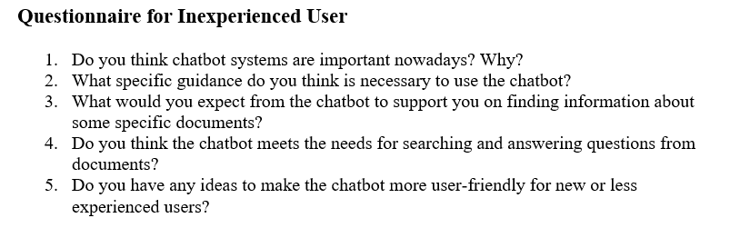
II. Needfinding methodology
Questions

Slide 7
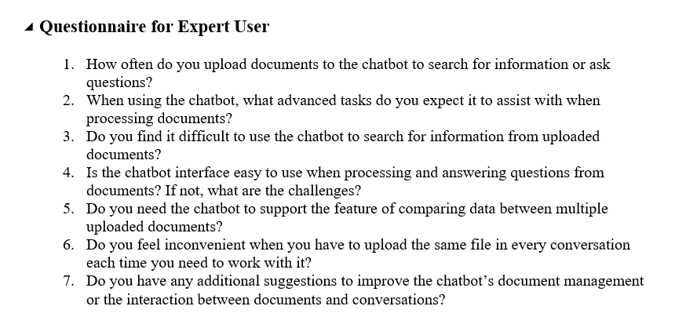
II. Needfinding methodology
Questions

Slide 8
II. Needfinding methodology
Participants
Sang
(Extreme user)
Thanh
(Normal users)
Nghia
(Expert user)

Slide 9
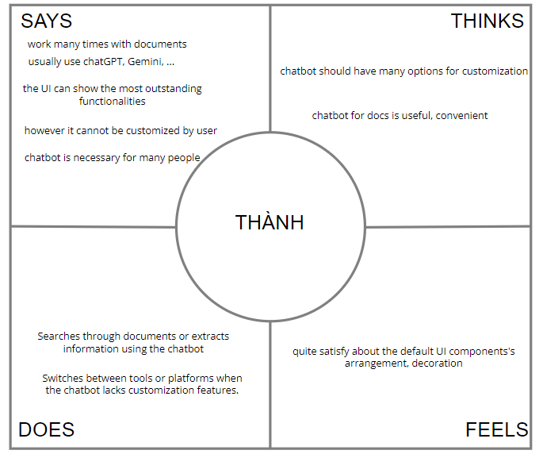
III. Interview / observation results
Thanh (21 years old)
4th year student from SEEE
Working with Chat GPT regularly but not using Document chatbot to analyze documents
(Normal user)

Slide 10
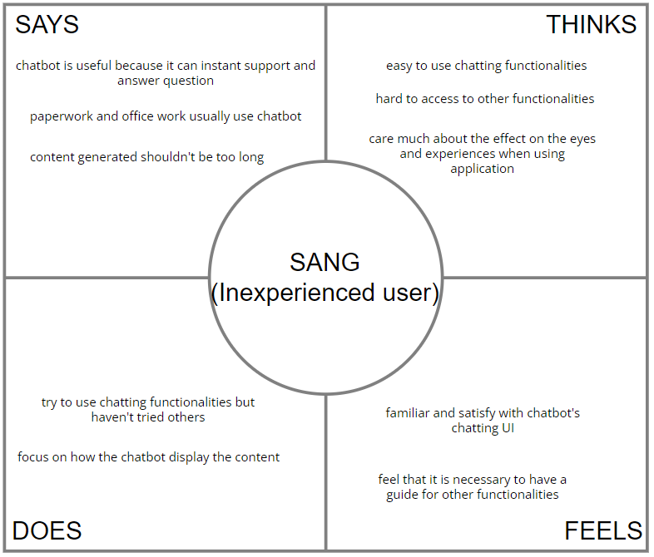
III. Interview / observation results
Sang (21 years old)
4th year student from EE-EP of SEEE
Rarely use Chat GPT or chatbot to analyze documents

Slide 11
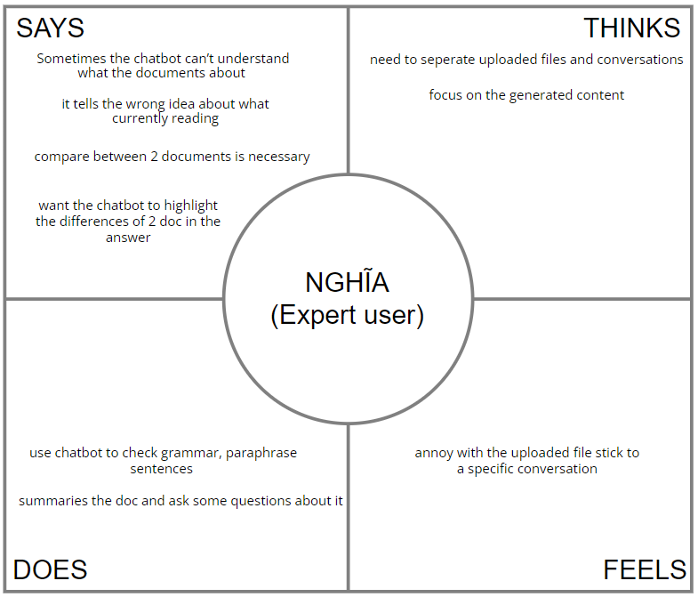
III. Interview / observation results
Nghia (20 years old)
3th year student from SEEE
Must work with digital documents regularly and use Chat GPT and Document chatbot to analyze documents

Slide 12
IV. Analysis
Thanh(Normal)
Needs
Customization options: Thành needs a chatbot that allows interface and feature customization for a personalized experience.
Quick information access: He requires a convenient tool for efficiently searching and extracting information from documents.
User-friendly interface: He appreciates the default UI but desires advanced customization for an enhanced user experience.
Insights
Desire for personalization: Thành values the chatbot’s utility but feels limited by the lack of customization, indicating a need for more personalized options.
Chatbot as a vital tool: The chatbot is essential for his work, suggesting it could be indispensable if limitations are addressed.
Appreciation for current UI: While satisfied with the current layout, he still seeks flexibility to better tailor the interface to his needs.

Slide 13
IV. Analysis
Sang(Extreme)
Needs
Guidance on additional features: Sang needs clear guidance for exploring functionalities beyond basic chatting.
Content clarity and brevity: He prefers concise responses from the chatbot to avoid overwhelming information.
Eye-friendly design: Sang is concerned about visual comfort and prefers an interface that reduces eye strain.
Insights
Lack of experience with advanced features: Sang is comfortable with chatting but avoids other functions, indicating a need for better onboarding or tutorials.
Importance of UI simplicity: He values a straightforward interface, especially one that emphasizes readability and ease on the eyes.
Preference for succinct responses: Sang feels that shorter, clear responses improve his experience, suggesting the chatbot should focus on brevity.

Slide 14
IV. Analysis
Nghia(Expert)
Needs
Document comparison: Nghia needs a chatbot that can highlight differences between two documents.
Improved content accuracy: He requires the chatbot to understand and accurately interpret document content.
Separate files and conversations: He wants uploaded files to be managed independently of specific conversations.
Insights
Importance of accurate content handling: Nghia’s frustration with misinterpretations suggests a need for enhanced document comprehension in the chatbot.
Need for flexible document management: His annoyance with file-conversation attachment indicates that a separate file management system would improve his workflow.
Focus on advanced functionality: As an expert user, Nghia values features like grammar checking and document comparison, indicating a preference for sophisticated, detail-oriented tools.

Slide 15
IV. Analysis
Tensions and Contradictions
Customization vs. Simplicity
Expert users want extensive customization, but the current design limits flexibility, frustrating those who need tailored experiences.
Conciseness vs. Detail
Inexperienced users prefer short answers, while experts need in-depth responses, creating a challenge in balancing response length.
Basic vs. Advanced Features
New users favor simplicity, whereas experts demand advanced functionalities, making it difficult to design a universally satisfying interface.

Slide 16
IV. Analysis
Surprises
Chatbot Integral for Complex Document
Users rely on the chatbot for advanced tasks like document comparison and summarization, making it essential to their workflow.
Customization Desired Across User
Both novice and expert users want customization options, suggesting that flexible design could improve satisfaction broadly.

Slide 17
V. Summary
Users need a flexible chatbot that balances simplicity with advanced features. It should handle complex document tasks, offer customization options, and support effective document summarization and querying to meet diverse user needs.

Slide 18
THANK YOU !

